Slide 1
lollipop chart
bar chart
side-by-side bar chart
barbell chart
● Males ● Overall ● Females

Slide 2
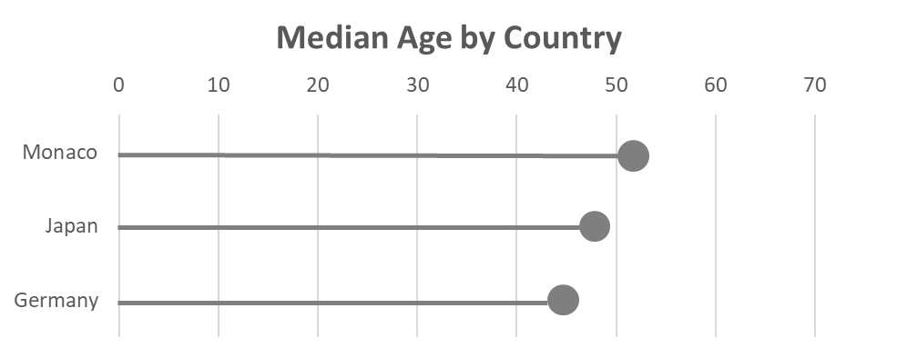

Slide 3
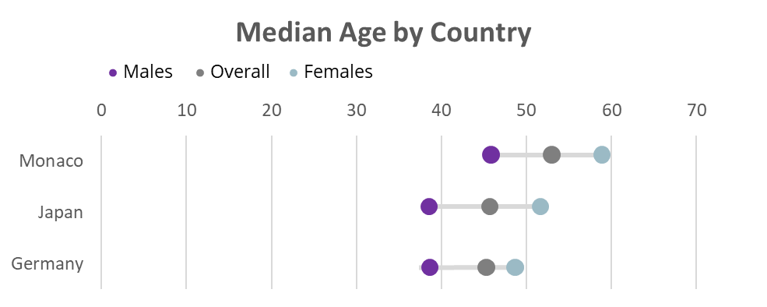

Slide 4
